Slide 1
Leveraging Census Data
Exploring and predicting post-secondary employment outcomes in the US

Slide 2
What are we looking at?

Slide 3

The US Census Bureau Post-Secondary Employment Outcomes (PSEO)
PSEO is an experimental dataset from the United States Census Bureau
Data coverage is high for only a few states
Tracks earnings and employment outcomes for graduates
Notes:
The US Census Bureau collects many more sets of data than just the 10 year census.
Covers many different areas: housing, economy, race, health, employment
Some suverys don’t have enough data to be a national survey.
PSEO is voluntary for state education systems

Slide 4
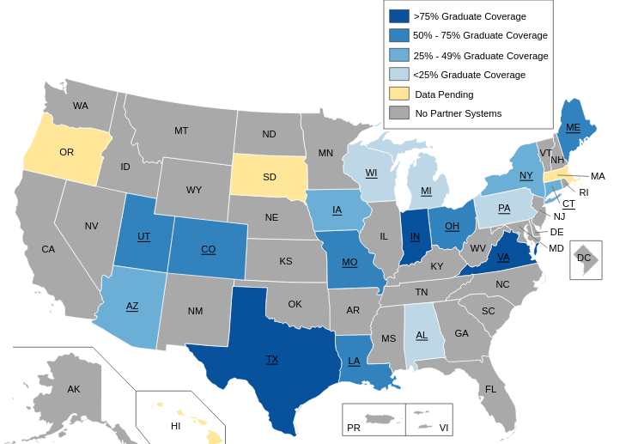
Data Coverage of PSEO dataset
Notes:
Since data is collected through data-sharing partnerships with State and University systems, many states don’t have data.
Texas, Indiana, and Virginia have the most coverage.
UT system and Texas Higher Education Coordinating Board share data for Texas Graduates

Slide 5
Integrated Postsecondary Education Data System (IPEDS)
The Integrated Postsecondary Education Data System (IPEDS) is a collection of data elements collected for every postsecondary education institution in the US on a diverse range of areas including the following: Institutional characteristics, Institutional prices / tuition, Admissions, Finances, and others.
We are interested in institutional characteristics such as as tuition and fees, room and board, institutional category (public vs private), degree of rurality (urban vs fringe), size of the institution (large vs small) as predictors of student post-graduate outcomes.
Notes:
Post Secondary Employment Outcome dataset has minimal information on the Universities and Colleges themselves. IPEDS fills that gap.

Slide 6
The Question

Slide 7
With all this data, what can we do?
Can we train a machine learning model on the available data and use that to predict post-secondary employment outcomes for graduates depending on their institution and degree type?
Notes:
We looked at degree level, type, and institution as predictors of earnings after graduation.

Slide 8
The Database

Slide 9
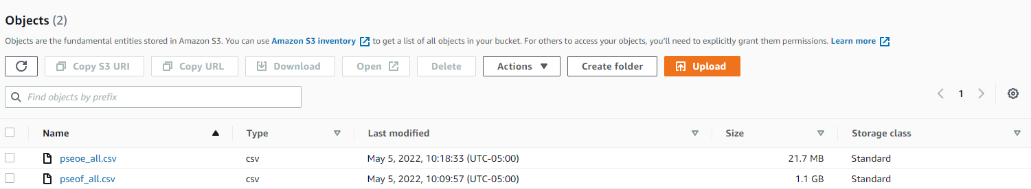
S3 Bucket
Notes:
Data was too big to easily transfer from one place to another, so decided to use S3 bucket to store.

Slide 10
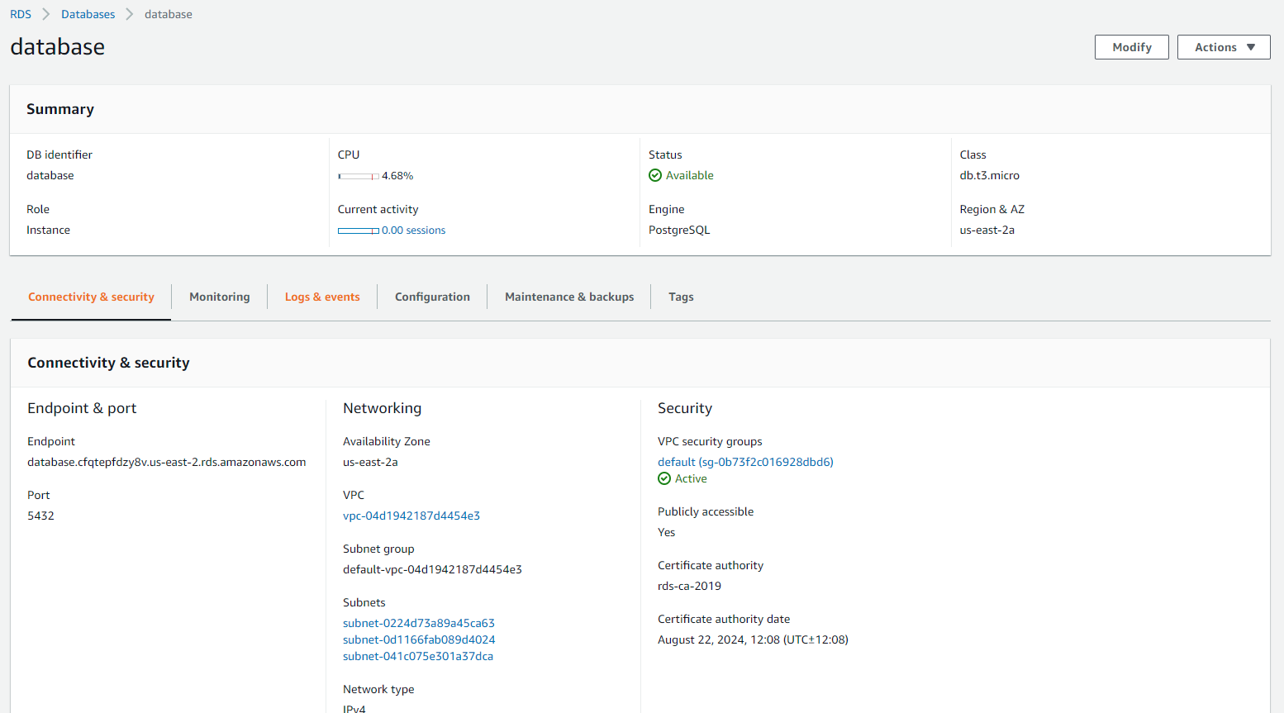
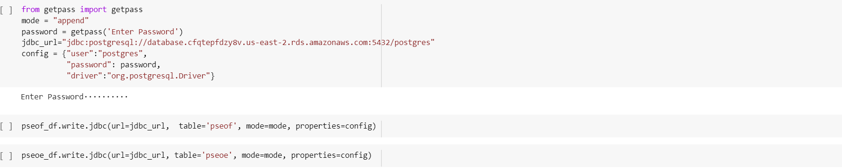
AWS RDS
Notes:
Using AWS RDS, was able to load and upload data to PostgreSQL

Slide 11
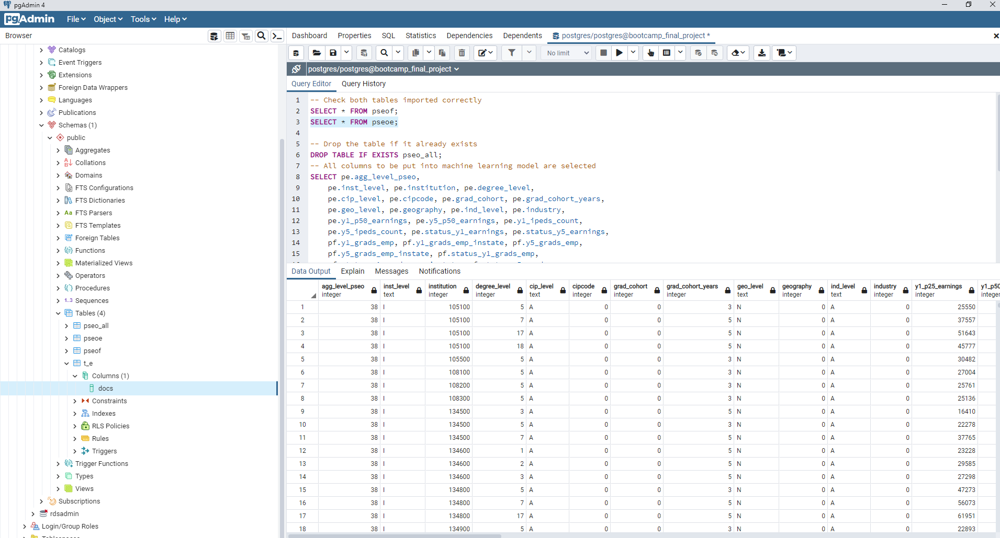
SQL
Notes:
After tables were created, data uploaded, we ran a query to make sure everything was correctly done.

Slide 12
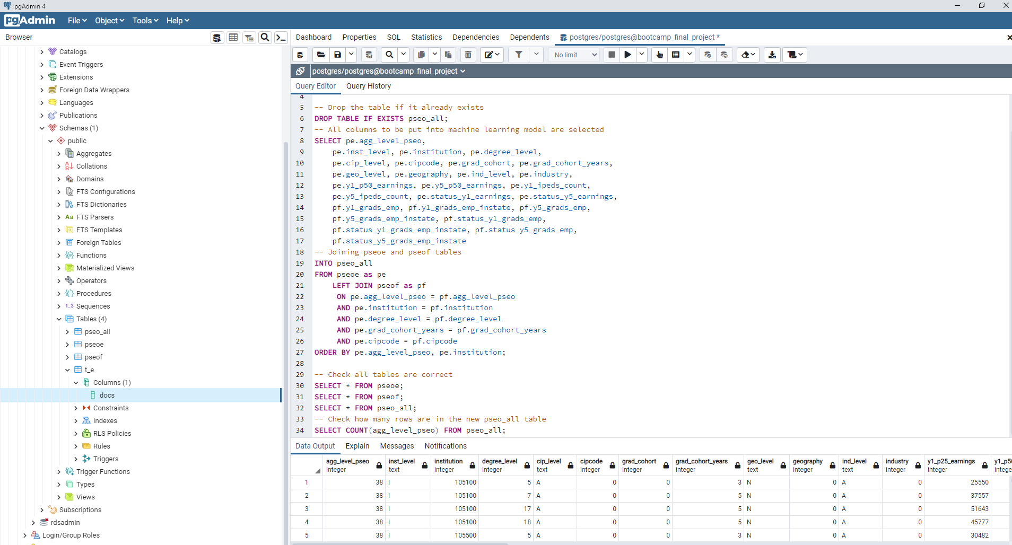
SQL Join
Notes:
Two tables were then joined based on 5 different criteria to ensure the data is joined correctly.

Slide 13
The Exploration

Slide 14
Finding out what each column represents
The names of many columns are vague or unclear. To find out what they stand for we referenced the LEHD Public Use Data Schema.

Slide 15
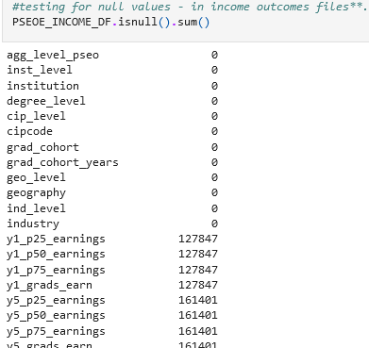
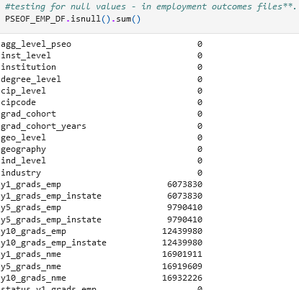
Looking for Null Values
Both the earnings and flows datasets have numerous rows that contain null values.

Slide 16
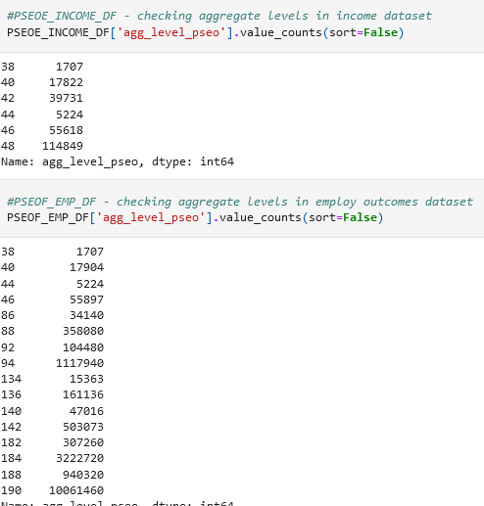
Checking Aggregation Levels
Each record is associated with an aggregation level that signifies the level of detail

Slide 17
The Analysis

Slide 18
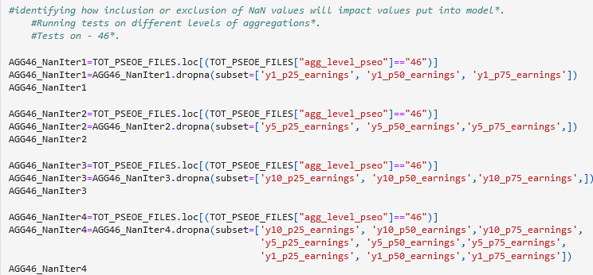
Deciding which columns to keep
We looked at how excluding records containing NaN values in the 1, 5, and 10 year outcome columns affected the data we had remaining.

Slide 19
Merging the two datasets
To keep things easier and cleaner we merged the flows and earnings datasets into one dataset.
A primary key column was created by merging column values that would uniquely identify each record.

Slide 20
The Dashboard

Slide 21
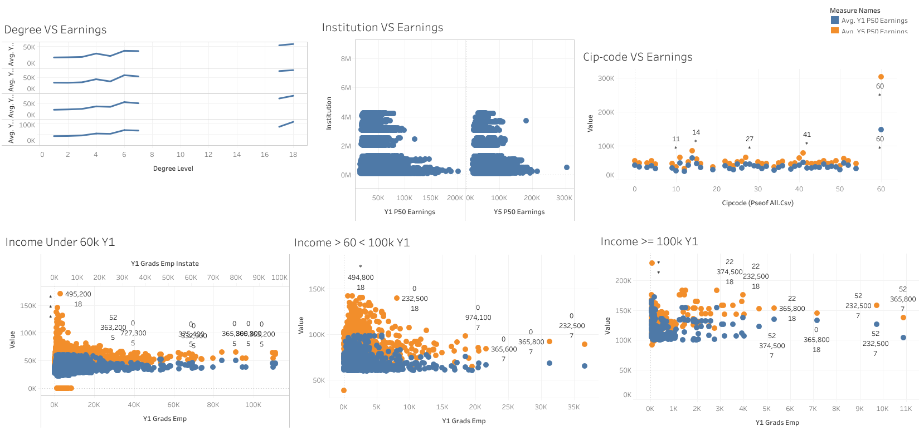
Search by name
Results
Filters
Cat 1
1
2
3
Cat 2
…
…
…
Cat X
Map of United States
Graphs aggregating results
Notes:
After analysis on Tableau, we solidified our theory that the most important factors to one’s earnings are: degree level, institution, and cip-code, all of which are encoded with numbers. Will show you what they are in the next slide. In blue, we have the average earnings of all the groups in the 1st year of employment and in orange, the 5th year of employment. In the degree vs earnings graph you can see that the higher the degree, the higher the average 1st year income. In institution vs earnings, you can see only a handful of institutions can give you an average 1st year income of more than 100k. In cip-code vs earnings, you can see that almost all fields of study are the same except for number 60. Interestingly, we discovered 2 things. 1. If you make more the first year, you are likely to make more the 5th year as well. 2. If you make more than 100k the first year, you income will increase less dramatically than those who make less than 60k the first year.

Slide 22
Tableau Story
https://public.tableau.com/app/profile/james.liu7227/viz/FinalProjectStory_16530613520890/Story?publish=yes
Notes:
Did relationship analysis on several features vs earnings: degree level, aggregation level, grad cohort, and institution. Grad cohort and aggregation level along with other features like geography and industry that have only one unique variable had little to no effect on average income. Whether there’s a high or low percentage of students who were employed in state didn’t seem to matter either. Higher the degree, higher the average 1st year income. Only a handful of institutions can produce students with an average income of more than 60k the 1st year. Almost all fields of study are the same except for residency programs with an average 1st year income of $148k. Here again, we see that it’s more common to see an increase in income of more than 30k in groups that make less than 60k the 1st year.

Slide 23
Tableau Interactive Page
https://public.tableau.com/app/profile/james.liu7227/viz/FinalProjectIncomeGroupInteractiveElement/HighestAverageEarningGroup?publish=yes
Notes:
If we take all the highest income groups and mash them together, we get the group who has a masters in a residency program and studied at Texas A&M System Health Science Center with an average 5th year income of $300,000!

Slide 24
Machine Learning

Slide 25
Goal
To create a machine learning model that predicts how much new graduates will make
The model was used to predict income for both the first and fifth year after leaving school

Slide 26
The Model
A neural network was used as it was found to be the most accurate for our project
One iteration of the model attempts to predict income
The other iteration attempts to predict whether or not your income will be more or less than the median income for that year

Slide 27
Results
The model can predict within $6,000 on average what you will make in your first year and within $9,500 for fifth year earnings
The model predicts roughly 78.5% of the time if you will make more or less than the median in your first year, and 77.5% of the time for fifth year earnings

